Slide 1

Capstone project - Final report
Correlation between a neighborhood real estate price and its surrounding venues
By, Anjali Madas

Slide 2
Introduction:
The main goal will be exploring the neighborhoods of New York city in order to extract the correlation between the real estate value and its surrounding venues
The idea comes from the process of a normal family finding a place to stay after moving to another city. It’s common that the owners or agents advertise their properties are closed to some kinds of venues like supermarkets, restaurants or coffee shops, etc.; showing the “convenience” of the location in order to raise their house’s value
The target audience for this report are:
1. Potential buyers who can roughly estimate the value of a house based on the surrounding venues and the average price
2. Real estate makers and planners who can decide what kind of venues to put around their products to maximize selling price
3. Houses sellers who can optimize their advertisements
4. And of course, to this course’s instructors and learners who will grade this project. Or to anyone who catch this shared on the social media showing that I can use Python data science tools

Slide 3
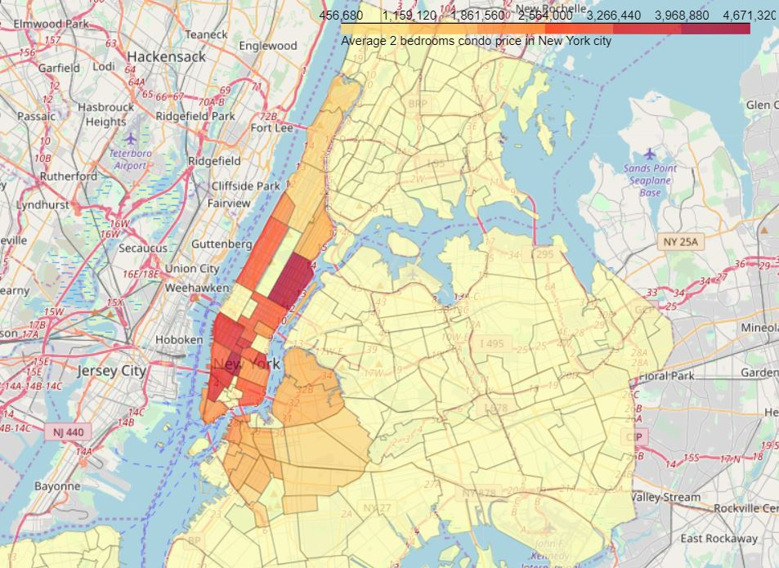
Methodology:
1. First insight using visualization:

Slide 4
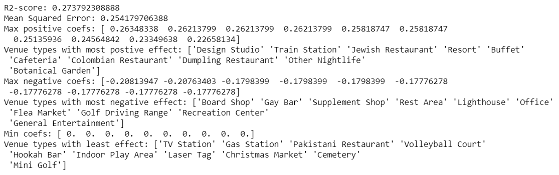
Methodology:
2. Linear Regression:

Slide 5

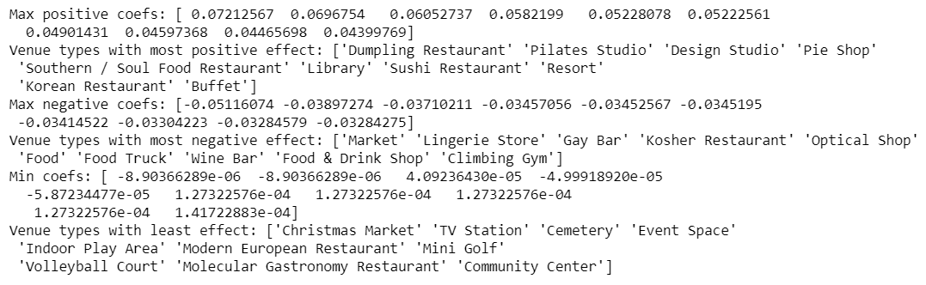
Methodology:
3. Principal Component Regression (PCR):

Slide 6
Results:
1. Even though the scores seem to be improved after applying a more sophisticate method, the model is still not suitable for the dataset. Thus, it can’t be used to precisely predict a neighborhood average price.
2. Explanations for the poor model can be:
The real estate price is hard to predict
The data is incomplete (small sample size, missing deciding factors)
The machine learning techniques are chosen or applied poorly
3. But again, on the bright side, the insight, gotten from observing the analysis results, seems consistent and logical. And the insight is business venues that can serve the needs of most normal people usually situated in pricy neighborhoods

Slide 7
Conclusion:
It’s unfortunately that the analysis couldn’t produce a precise model or showing any strong coefficient correlation for any venue type. But we can still get some meaningful and logical insights from the result
Some notes on the analysis result:
- This project is done by a web developer who only started self-studying Data Science for 4 months. So please take it with a grain of salt
- The coefficients only show correlation, not causation. So, if your neighborhood average price is low, please don’t go destroying the surrounding bars and food trucks. There might be another reason

